Slide 1
MOD005701
Quantitative Methods for Banking and Finance
Week 7 Introduction to Multivariate Regression

Slide 2
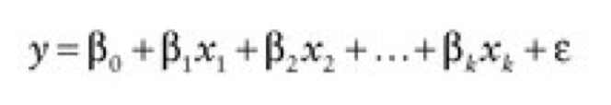
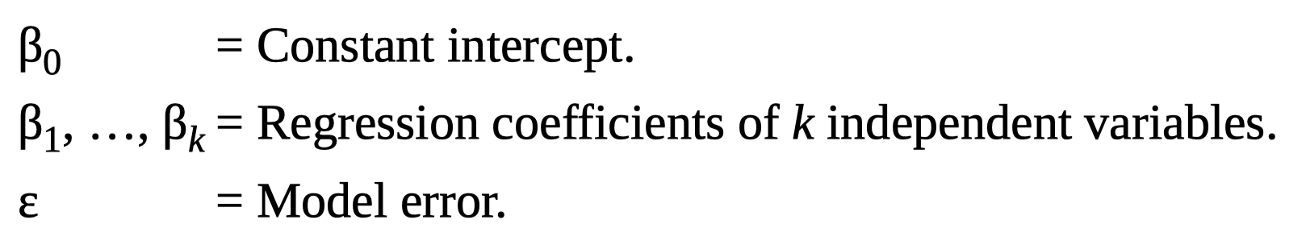
The multivariate linear regression model
The multivariate linear regression model for the population is of the form:
Where:

Slide 3
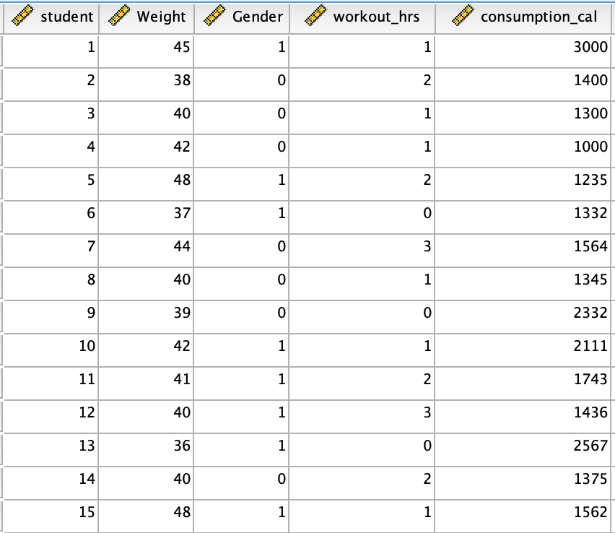
Example: the factors affect the weight
Y=weight
X1=gender
X2=workout_hrs
X3=consumption_cal

Slide 4
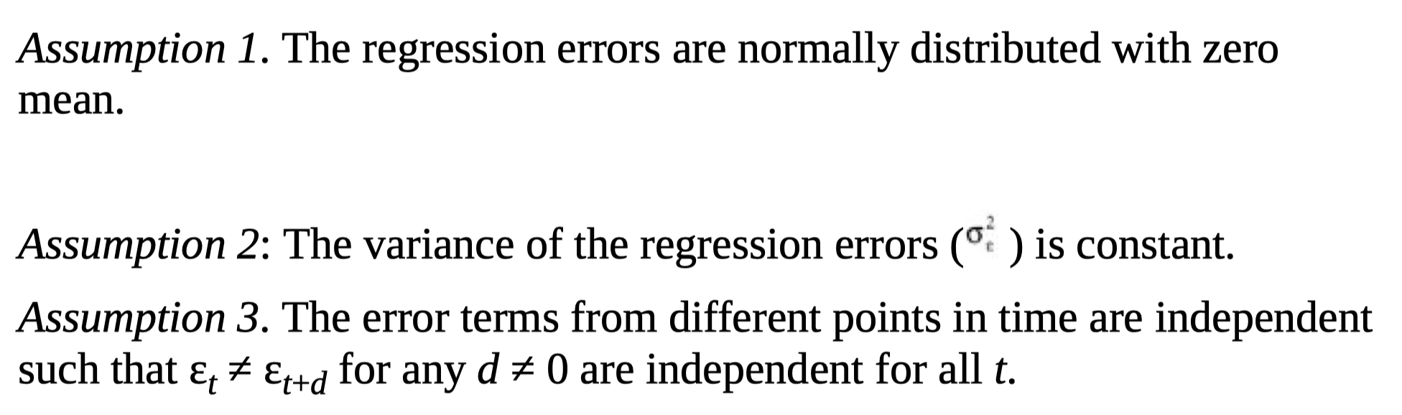
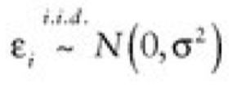
Assumption of multiple linear regression
Formally, we can restate the above assumptions in a concise way as

Slide 5
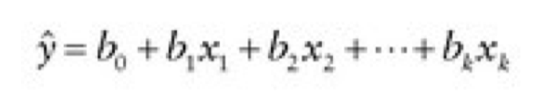
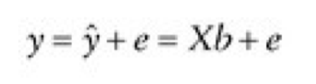
Estimation of the model parameters
The estimated regression is
The matrix notation analogue is
Each of the k coefficients determines the slope in the direction of the corresponding independent variable. In the direction of the k+1st dimension of the y values, we extend the estimated errors, e = y − ŷ . At each y value, these errors denote the distance between the hyperplane and the observation of the corresponding y value.

Slide 6
Designing the model
This building process consists of three steps:
1. Specification-determine the dependent and independent variables
2. Fitting/estimating-the larger the sample, the better the quality of the estimation (at least, four times k)
3. Diagnosis-evaluating the quality of the regression

Slide 7
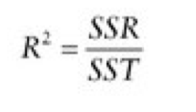
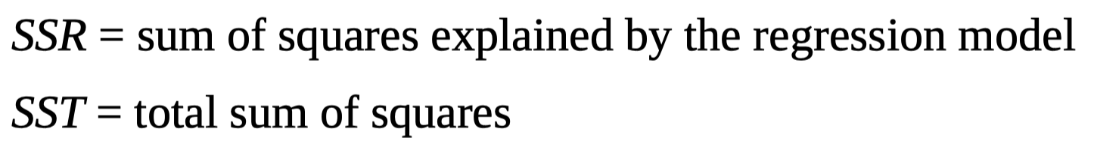
DIAGNOSTIC CHECK AND MODEL SIGNIFICANCE
The goodness-of-fit measure is the coefficient of determination – the R squared
The R squared of the multivariate linear regression is referred to as the multiple coefficient of determination
Where:

Slide 8
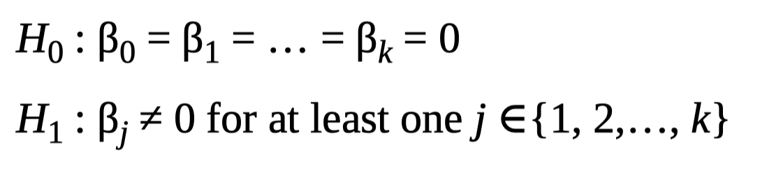
Testing for the Significance of the Model
To test whether the entire model is significant, we consider two alternative hypotheses.

Slide 9
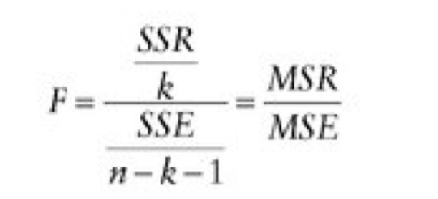
ANOVA
To perform the test, we carry out an analysis of variance (ANOVA) test. In this context, we compute the F-statistic defined by
where SSR sum of squares explained by the regression model
SSE = unexplained sum of squares
MS =the mean squares of regression
MSE=the mean squared of errors
n - k – 1=the degrees of freedom of the SSE
k =The degrees of freedom of the SSR

Slide 10
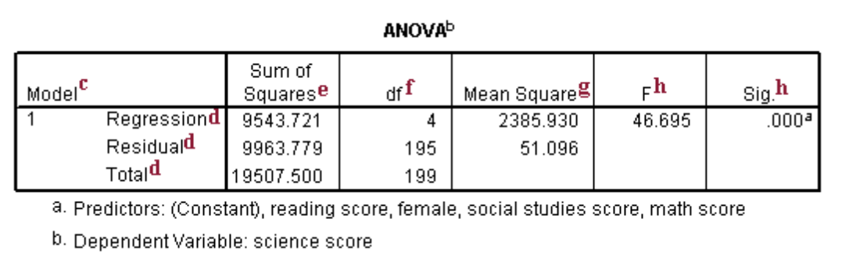

Rules of ANOVA
If the statistic is found significant at some predetermined level (i.e., $P_{F}$ < α), the model does explain some variation of the dependent variable y.
ANOVA SPSS OUTPUT

Slide 11
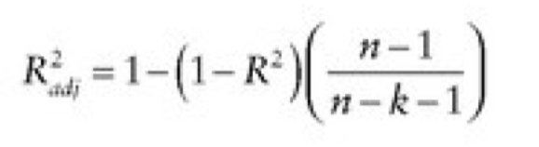
Adjusted R-squared
A redefined version of the coefficient of determination
The best R squared is not necessarily an indicator of the most useful model.
if one uses the fitted model for a different set of data, the weakness of the over-fitted model becomes obvious.
Adjusted R-squared given by
N=the number of observations
K=number of observations (including the intercept)

Slide 12
R-squared vs Adjusted R-squared
As long as the number of observations is very large compared to k, R-squared and adjusted R squared are approximately the same.
if the number k of independent variables included increases, the adjusted R-squared drops noticeably compared to the original R-squared
Include as many variables as you can, cannot provide a better fitness of your model

Slide 13
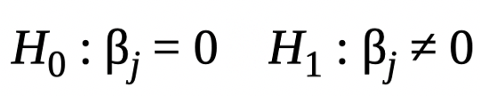
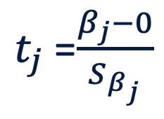

Testing for the Significance of the Independent Variables:T-test
Formally, for each of the k independent variables, we test
By using T-test:
$t_{j}$=$\frac{β_{j}−0}{S_{β_{j}}}$
$β_{j}$=the sample estimate of the j-th regression coefficient
$S_{β_{j}}$ = the standard error of the coefficient estimate.

Slide 14
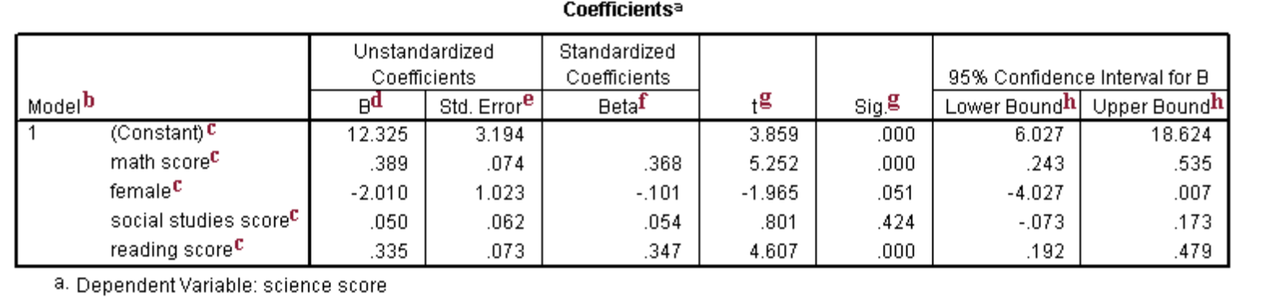
Rules of T-test
If the p-value would then be less than α, then the independent variable is said to be statistically significant.

Slide 15


The F-Test for Inclusion of Additional Variables
To check whether it is appropriate to add another independent variable to the regression model, we need a test statistic measuring the improvement in the goodness-of-fit due to the additional variable.
Suppose we consider the multiple regression model
complete model:
Reduced model:
Whether the reduced is significantly no worse than the complete model?
i.e. want to determine whether b₃, b₄ and b₅ add significant benefit to the model

Slide 16
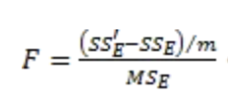
Rules of F-test
The null hypothesis H₀: b₃ = b₄ = b₅ = 0
m = number of independent variables being tested for elimination (m=3)
SS’_{E} is the value of SS_{E} for the model without these variables
Rules of decision making: If the p-value would then be less than α, then we accept the null hypothesis, i.e. the additional independent variable do not add significantly to the model and so cannot be eliminated.

Slide 17
SPSS Practices in the Seminar

